Slide 1
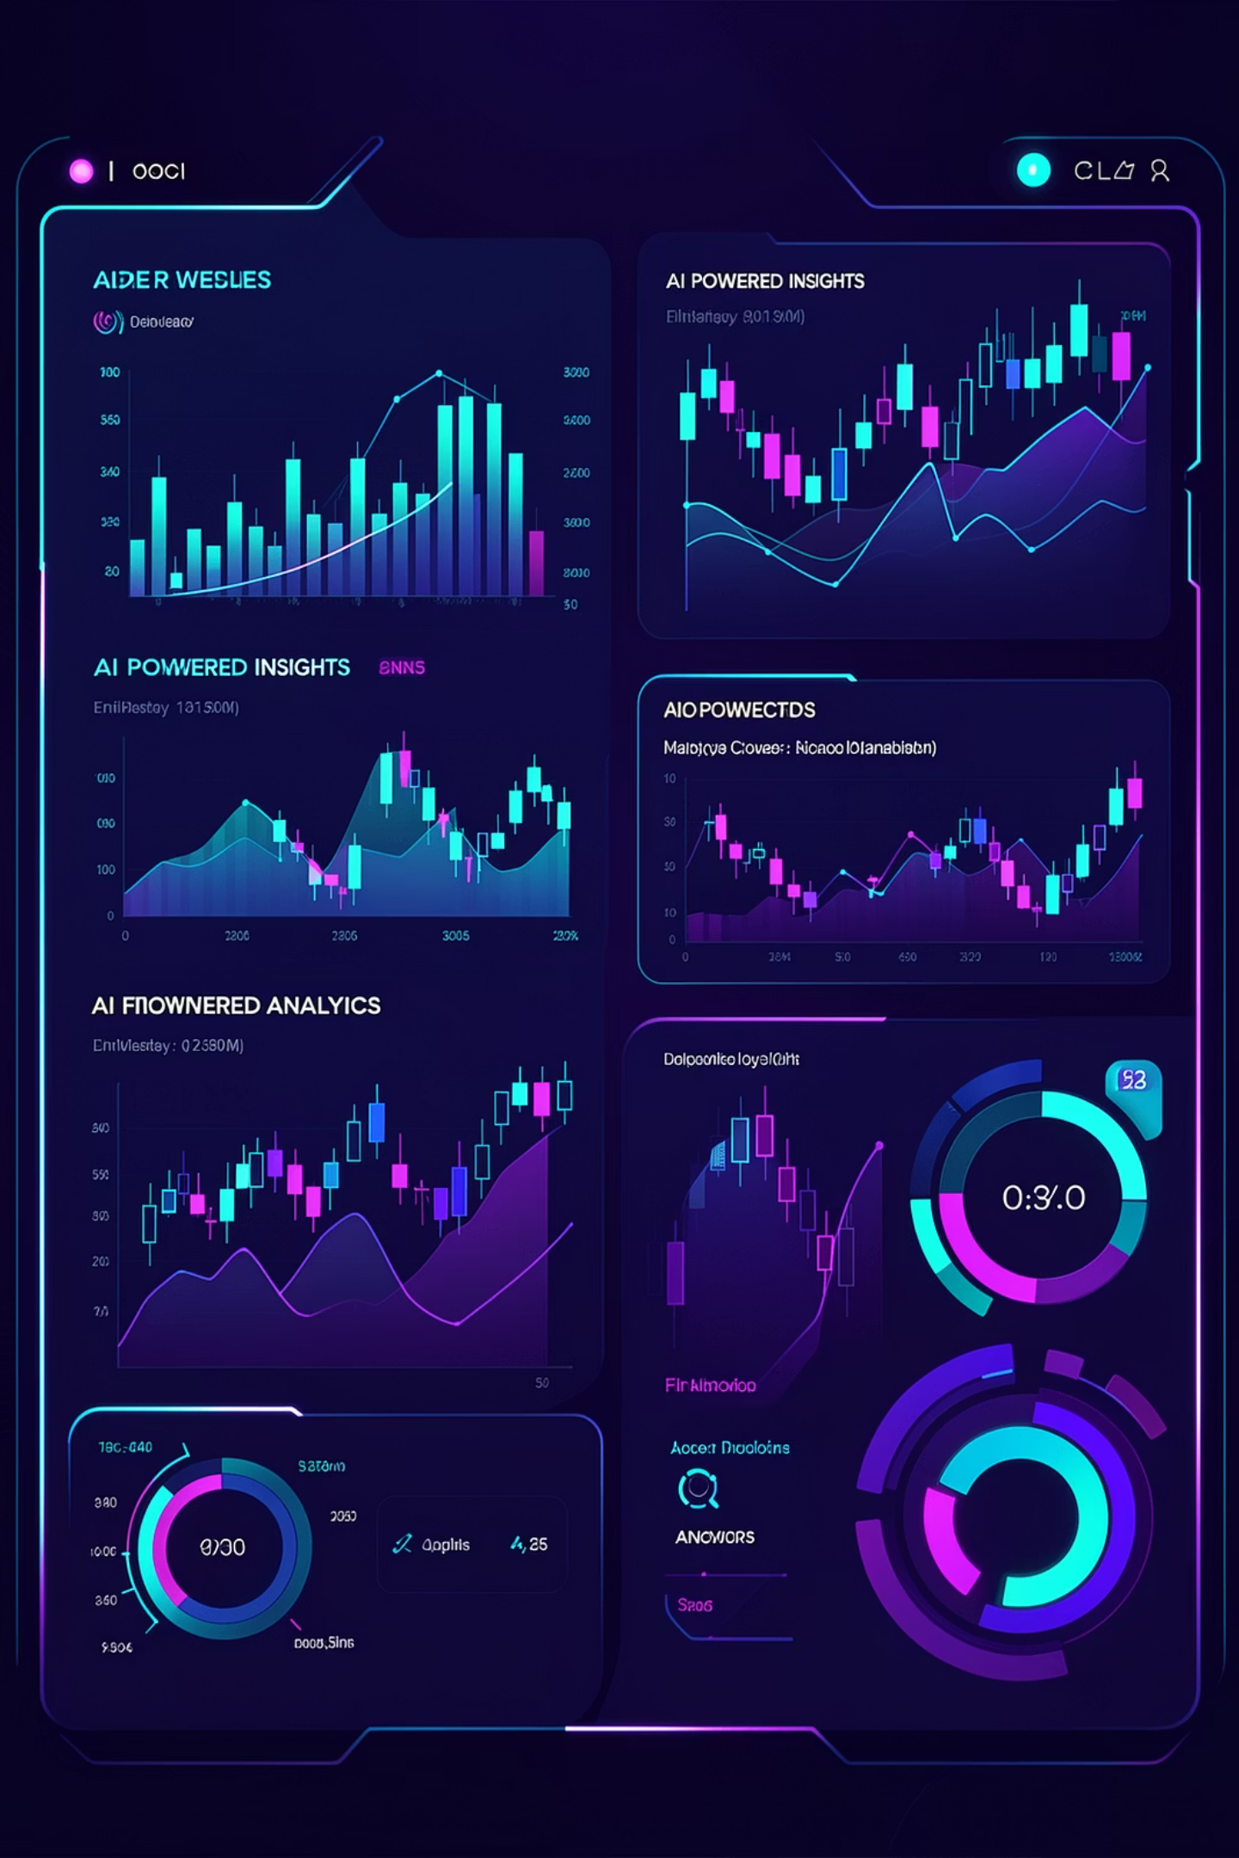
AI-Powered Analytics Agent
From Questions to Insights in Seconds

Slide 2


The Problem
Current loan collection reporting creates bottlenecks
Time Delays
Technical Barriers
Hours to generate reports
SQL and dashboard skills required
Delayed Decisions
Manual analysis slows response

Slide 3

Our Vision
Ask in Plain English
No technical skills needed
Get Instant Answers
AI analyzes and visualizes automatically

Slide 4





How It Works
Ask Question
Plain English query
AI Interprets
Understands intent
Clarify
Follow-up questions
Fetch Data
Auto-generate SQL
Visualize
Chart + insights

Slide 5


System Architecture
Streamlit UI
User interface
Qwen AI Models
Language understanding
PostgreSQL
Data storage
Plotly
Visualizations
Runs fully on-premise—no external data sharing

Slide 6
Key Features
Natural Language
Smart Follow-Up
Ask questions like you'd ask a colleague
AI asks clarifying questions
Auto SQL
Smart Charts
Generates queries automatically
Automatic visualization selection
AI Insights
Interactive
Interprets patterns and trends
Real-time dashboard exploration

Slide 7
Business Impact
Minutes, Not Hours
No Analyst Dependency
Productivity Boost
Real-time insights drive faster decisions
Everyone accesses data independently
Eliminate manual reporting work
Consistent Reporting
Better Strategies
Standardized analysis across teams
Data-driven approaches

Slide 8
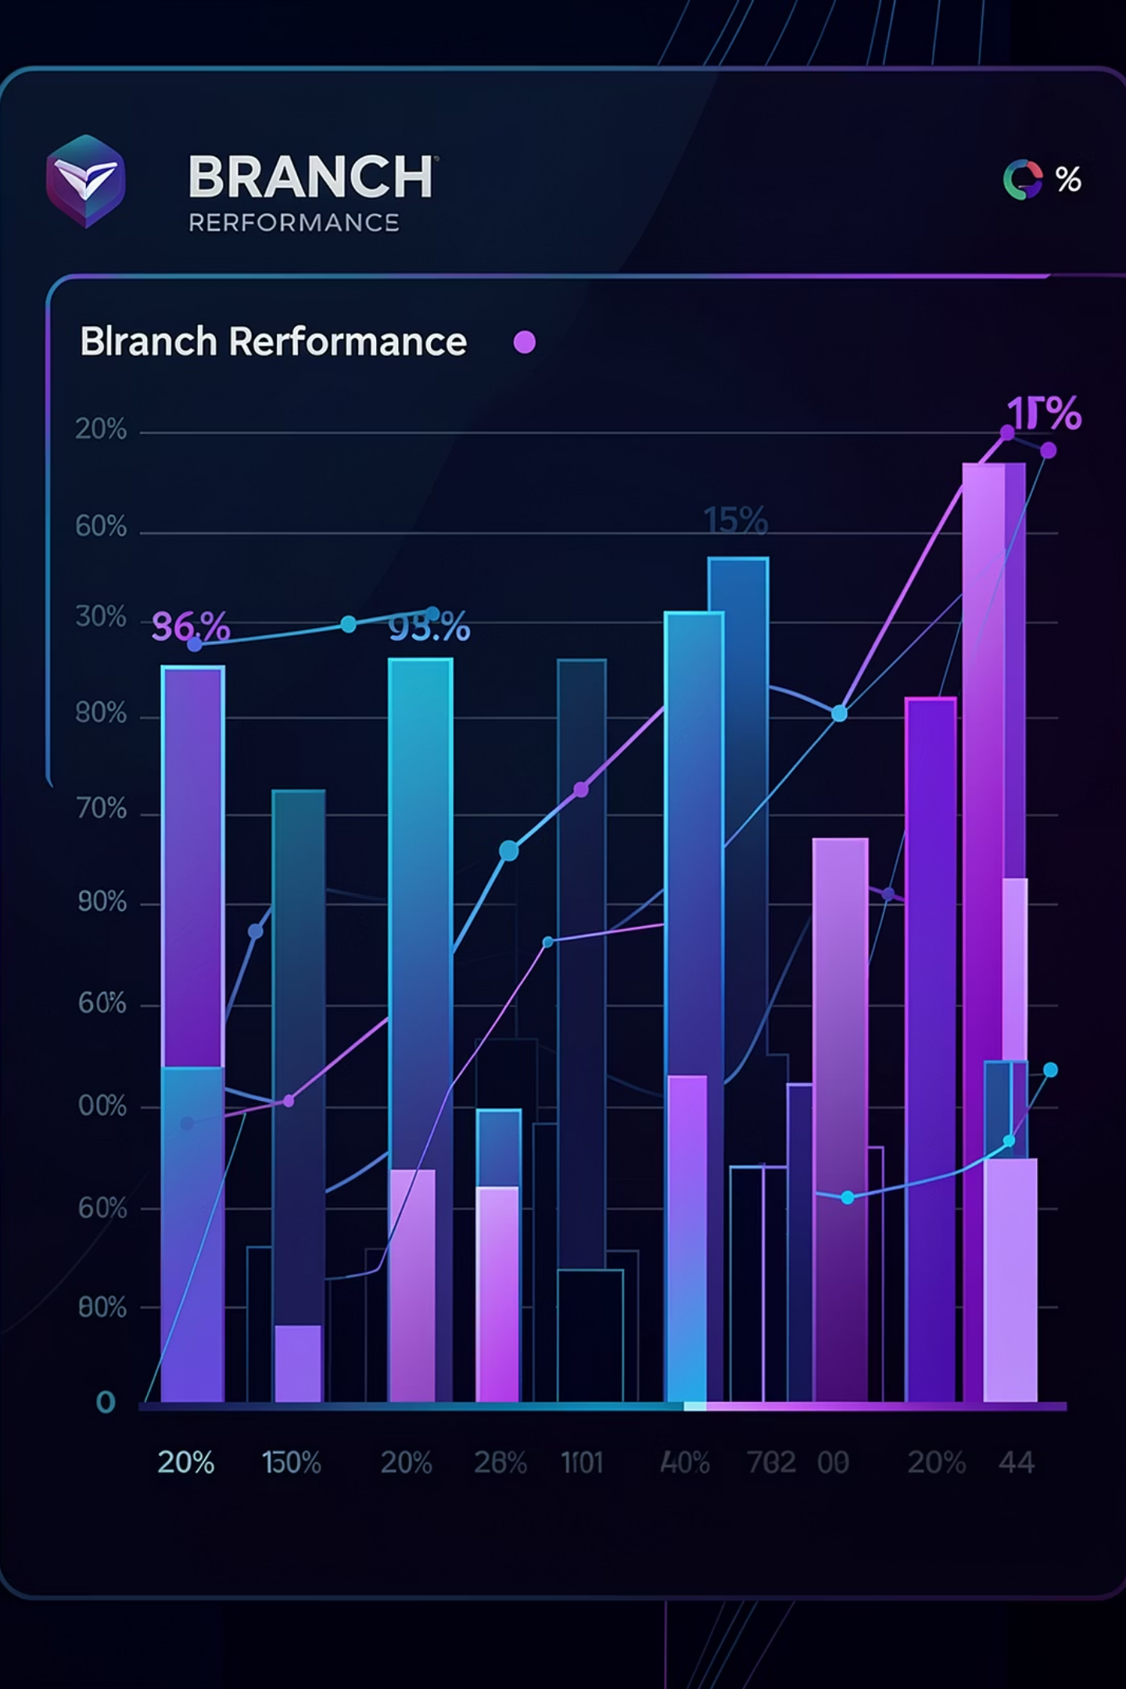
Example Use Case
"Show bounce rate by branch"
AI Interaction
Output Generated
Asks for region filter
Requests month range
Confirms data scope
Branch comparison chart
Top performers highlighted
High-risk areas flagged

Slide 9
Deployment Options Comparison
Choosing the right deployment model is crucial for optimising performance, cost, and data privacy for your AI-powered analytics agent. This table outlines the key considerations across three common options:
Factor
API (Mini)
Cloud GPU
Local Server
Setup Cost
₹0
₹0
₹3.5L – ₹4.5L
Monthly Cost
₹8K
₹18K – ₹57K
₹1K – ₹4K
Cost / Request
₹0.28
₹0.6 – ₹2
₹0.55 – ₹0.8
Scalability
⭐⭐⭐⭐⭐
⭐⭐⭐⭐
⭐⭐
Maintenance
None
Low
High
Accuracy
⭐⭐⭐⭐⭐
⭐⭐⭐⭐
⭐⭐⭐
Data Privacy
Medium
Medium
⭐⭐⭐⭐⭐
While API and Cloud GPU options offer lower initial costs and higher scalability, a local server provides superior data privacy and predictable costs, making it ideal for sensitive financial data.

Slide 10
Future Roadmap
Multi Visual Dashboards
Multi-Table Queries
Real-Time Data
Enterprise Scale
Towards AI-Driven Decision Making

